Slide 1

LING 170: Introduction to conversation analysis in Rezonator
Ryan Ka Yau Lai
University of California, Santa Barbara

Slide 2




While we’re waiting …
If you already have Rezonator, download these slides and open them in PowerPoint (so that you have access to the videos)
If you don’t have it yet, try to install it
During/after this class (you can do it now), send me an email with your:
Name
Pronouns (if you’re comfortable sharing)
Major
Why are you taking this course?
Would you like to work with Spanish or Mandarin texts, or work with a particular person in your section? (Feel free to email me this later if you decide later)
The codeword on the board

Slide 3
Who am I?
I’m your TA this quarter
Ryan Ka Yau Lai 黎嘉祐 [lɐɪ˨˩ kɑ˥ jɐʊ˨]
4th year PhD student in linguistics at UCSB
Work on corpus-based discourse & grammar studies
Especially issues related to reference
Including with attention to social interaction (focus of this course)
Created and maintain a package for working with Rezonator data in R
Languages I work with: Classical & Central Tibetan; Old & Middle Chinese + modern Cantonese & Mandarin; English; Japanese; P’urhépecha (Indigenous language of Michoacán, Mexico)
Office hours: 10-12 on Wednesdays, SH 5431 G

Slide 4

I’d like to get to know you too!
Tell us all a boring fact about yourself (no need to think too hard)

Slide 5
Some things about this class & how I will teach …

Slide 6
What does Rezonator do?
Display
Display conversational transcripts
Visualise
Visualise relationships between different parts of conversation
Store
Store data in a format for quantitative analysis
Search
Search conversational transcripts to find language phenomena of interest
We will learn most of these things soon:
https://rezonator.com/features/

Slide 7
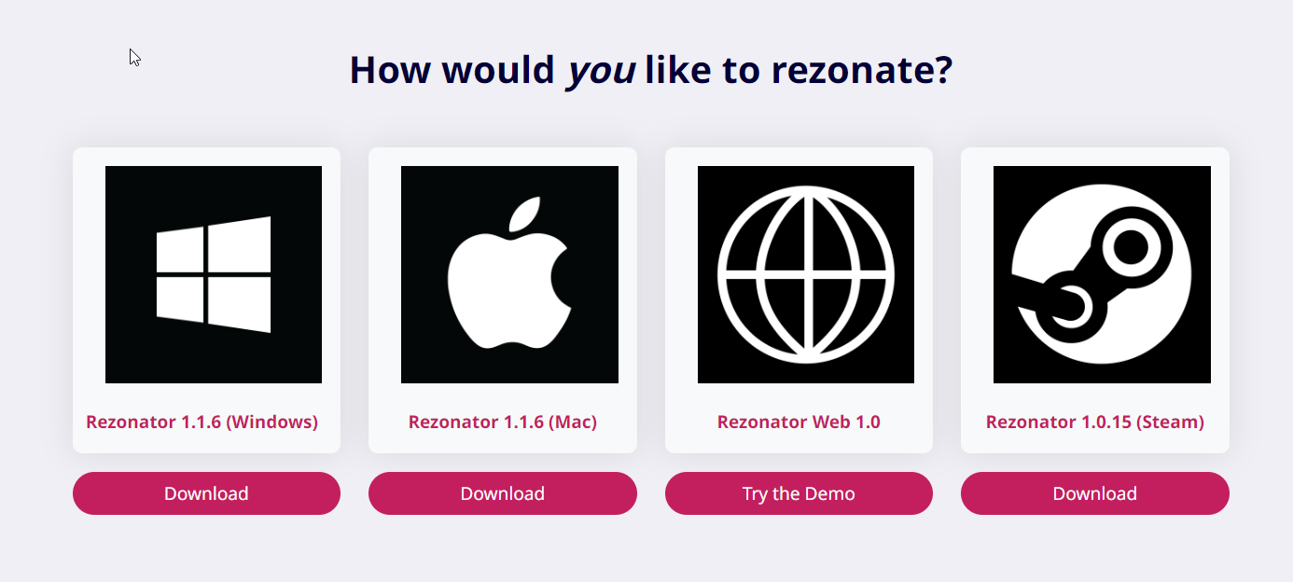
Installing Rezonator
https://rezonator.com/download/
Unzip the file and run Rezonator.exe
Video guide (especially for Mac users facing issues): https://rezonator.com/guide/

Slide 8
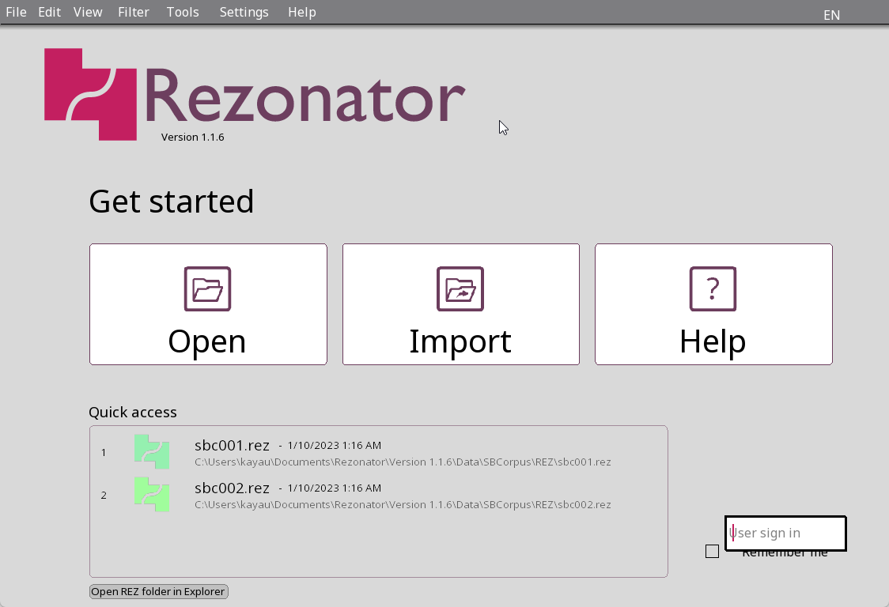
Opening Rezonator
The start screen should look like this (may be in your system’s language)
You can change the language on top right
Note: If you want my help in class, please change the language to one I can understand (English, Chinese, Japanese or Spanish)

Slide 9
Opening a transcript – quick access
Try to open the second file in ‘Quick access’

Slide 10
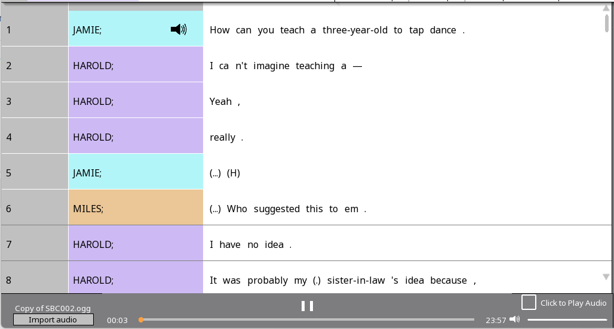
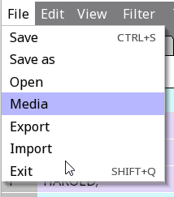


Downloading media files
Go to the class Google Drive at shorturl.at/eBCKR (full link available at Canvas)
Download file at 'Corpus > Santa Barbara Corpus > ogg 124 > Copy of SBC002.ogg’
Open in Rezonator using File > Media
Now you should see a media bar at the bottom
Note: You cannot open a media file alone – you must have a transcript open!

Slide 11
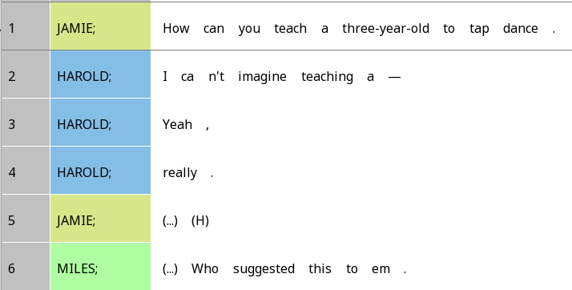
Units
Each line in Rezonator is called a unit
In the Santa Barbara Corpus, every line is an intonation unit – we’ll learn what that means later
Numbered: Shown here are 1-6
Line numbers
Participant labels

Slide 12
Tokens
In the text, each element separated by a space is a token
Largely words, but also:
Contractions : n’t
‘Punctuation’ – we’ll learn about what they mean exactly later
Pause: (…)
Breath: (H)

Slide 13
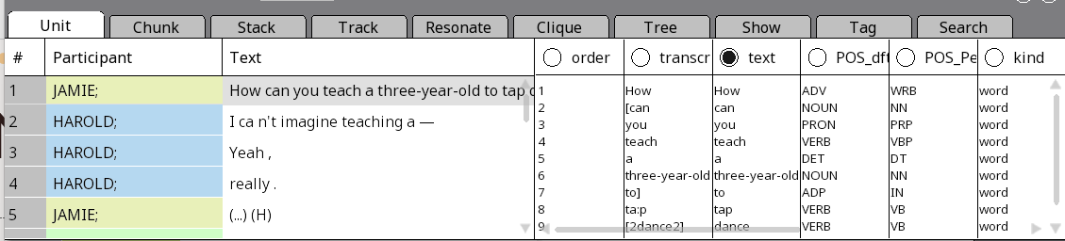
Navigation window
For the first part of this class, we will use only the Unit tab
Left part: Each line is a unit
Right part: Each line is a token in the currently active unit

Slide 14
Text vs. Transcript
Right part: Each column is a property of the token
The selected column (solid dot) = what gets shown in the main screen
What if you click on the circle next to ‘transcript’?

Slide 15
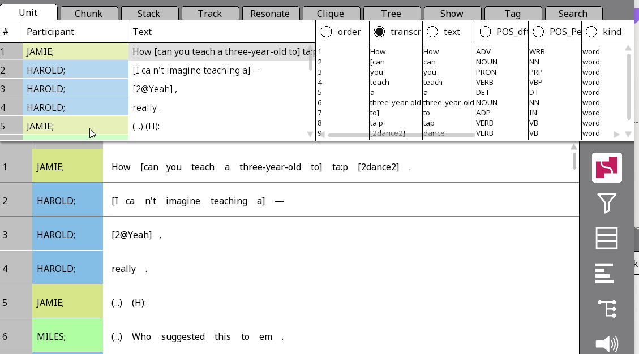
Text vs. Transcript
Now the transcript looks less ‘clean’!
We get:
Overlap brackets ([ ], [2 2])
Laughter quality (@)
Lengthening ((H):)

Slide 16





One-to-many vs. one-to-one
Right now, we are in one-to-many view: One unit on the right side, many tokens on the left side
What if you click on the one-to-many button on the right-hand sidebar?

Slide 17
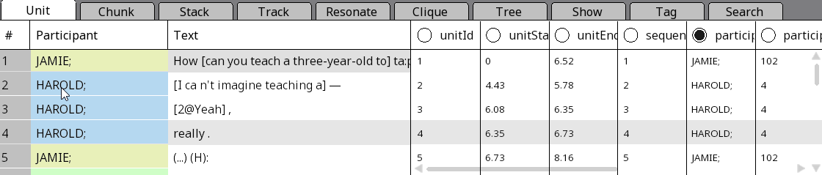



Using one-to-one view to see Unit properties
When does the unit start & end in the audio file (in sec.)?

Slide 18
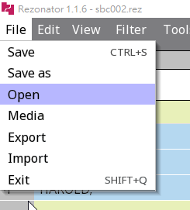
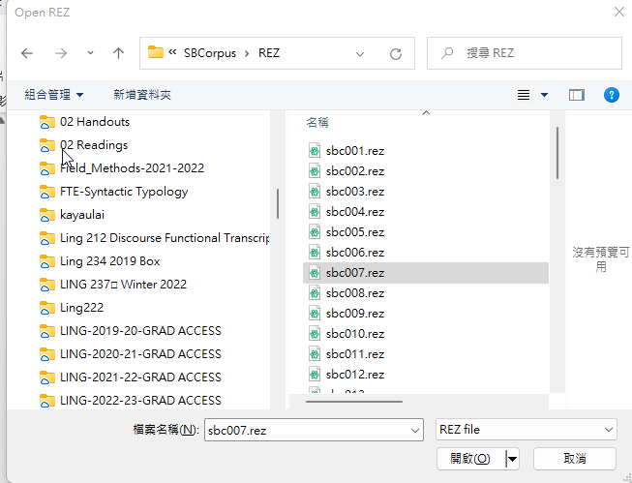
Opening a different transcript
Now we’ll try to open another file – use File > Open
You should have Santa Barbara Corpus files in a path like (something)\Rezonator\Version 1.1.7\Data\SBCorpus\REZ\
Open sbc007.rez

Slide 19
Note on texts!
For the rest of the course, you will work on one text from:
English (Santa Barbara Corpus of Spoken American English)
Mandarin (NCCU Taiwan Mandarin Corpus)
Spanish (CallHome corpus)
Please inform me if you would like to work on Mandarin or Spanish.
If you are interested in making more Mandarin or Spanish texts available, please talk to me
We have a research group working on Mandarin texts in LING 199 (ultimate goal is 49 texts)
For Spanish, you could do work on a text as one of the extra credit options in this course; if there’s enough interest, we might form an ad hoc group for Spanish as well

Slide 20
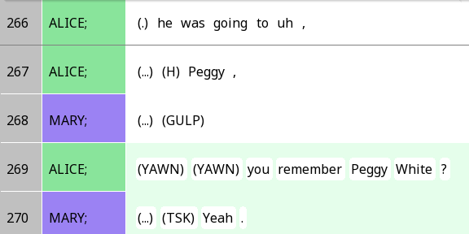
Stacks
Now let’s try out a new feature: Stacks
Stacks are one of the structures you create in Rezonator
A stack is basically a group of units (lines)
Units in the same stack are shaded with the same colour (e.g. green)

Slide 21
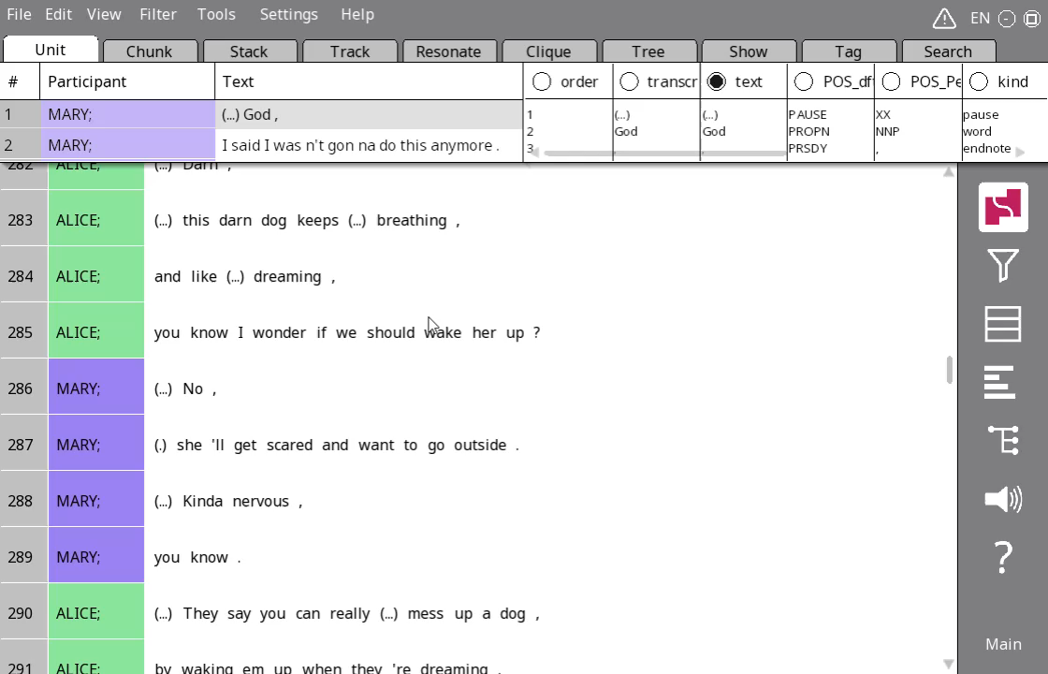
Quick stacks
There are multiple ways to create stacks
In this class, we will use the easiest way (drag-and-drop)
Click on the first unit, then drag to the last unit of the intended stack
To make a second stack, exit the current one with your Esc key, or click on a white area of the screen

Slide 22
Turns again …
We will keep revising the concepts of turns this quarter
For now, a ‘turn’ is a segment of speech where one person is the one speaking, and other people are listening
Backchannels (e.g. yeah, right, mhm) are used to express comprehension and alignment with the speaker without taking the speaker role from them

Slide 23
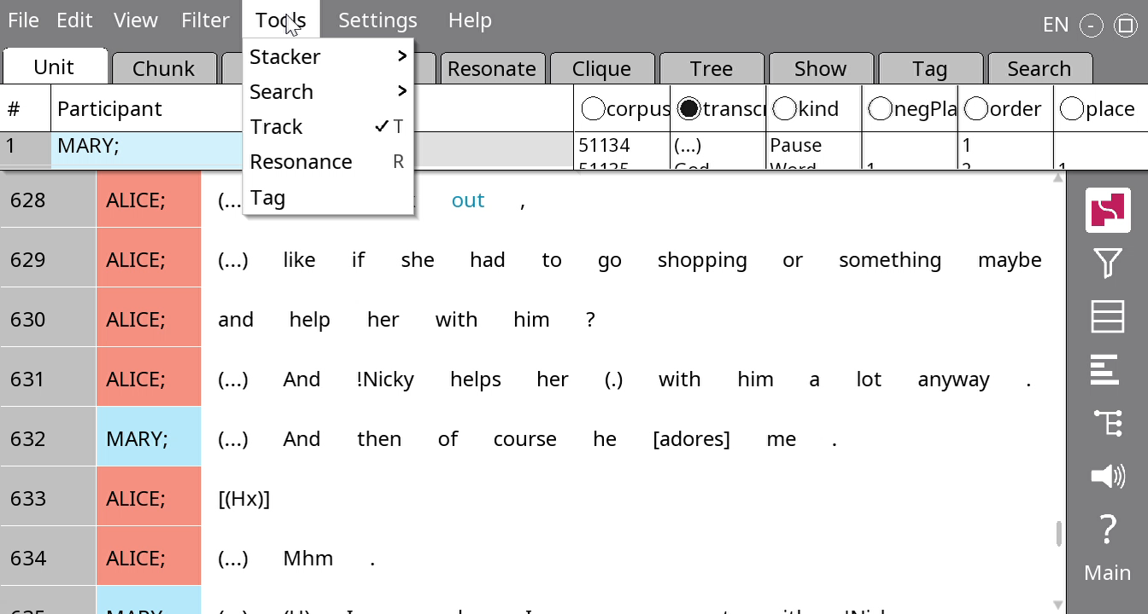
The turn stacker
Click Tools > Stacker > From participant labels, and type Turn

Slide 24
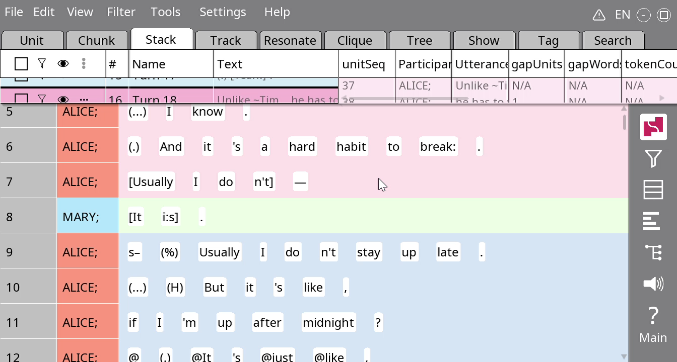
Merging turns
Click on the ‘swallowing’ turn
Hold the CTRL button
Click on the ‘swallowed’ turn
Press OK

Slide 25
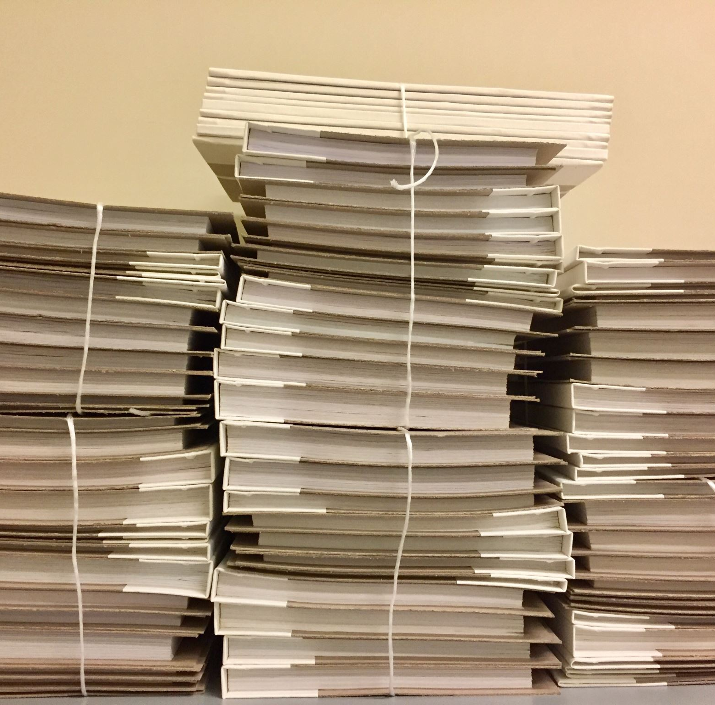
Your turn!
Try to turn the stacks into more meaningful turns in ~100 lines of Rezonator
In what situations do you need to merge turns?

Slide 26
A note on stacks
If you’re using Rezonator <1.2.0 (this includes Steam users), you can only have one set of stacks at a time
So if you want to have multiple kinds of stacks (e.g. one for turns and one for questions vs answers), you should keep multiple versions of the same ile

Slide 27

Save before you leave!
Save the file with Ctrl + S or File > Save!

